Slide 1


Asia-Pacific Cardiovascular Disease Alliance
Week 0 soft launch plan

Slide 2
Contents
Week 0 Launch of the Alliance
Medium | Distribution | Possible exclusives | Journalists
Press release | MediaOutreach newswire (see list of publications enclosed) Alliance website ACCESS Health comms Company comms Strategic partner comms | Straits Times CNA STAT | Linette Lai (Straits Times) Jennifer Rigby (Reuters) Elaine Chen (STAT) Sherlyn Seah (CNA) Mike Miliard (Healthcare IT) Tina Jacks (The Age) Anton Delgado (SEA Globe) Carmen Paun (Politico) South China Morning Post The Telegraph in Bangkok
Social media posts | Alliance Facebook and LinkedIn (see draft) | - | -
 | LinkedIn and Facebook (Amgen) | - | -
 | LinkedIn and Facebook (Novartis) | - | -
 | LinkedIn and Facebook (Roche) | - | -

Slide 3




Objectives of the soft launch
Raise awareness of the Alliance to the health and policy community in Asia
Showcase who we are and why an Alliance is needed in Asia
Support ongoing outreach activities
Press release
Website
https://demowebsg2.com/asiapacific/
Charter
Social media

Slide 4

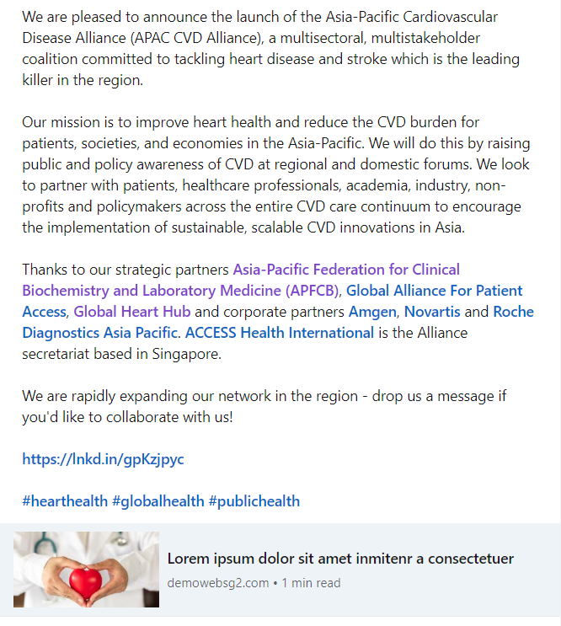

Week 0 soft launch
Alliance website

Slide 5

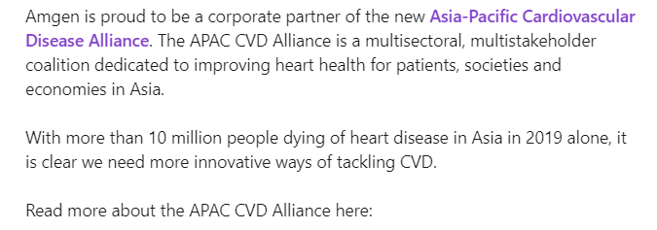

Social media (Amgen)
Draft text
Amgen is proud to be a corporate partner of the new Asia-Pacific Cardiovascular Disease Alliance. The APAC CVD Alliance is a multisectoral, multistakeholder coalition dedicated to improving heart health for patients, societies and economies in Asia.
With more than 10 million people dying of heart disease in Asia in 2019 alone, it is clear we need more innovative ways of tackling CVD.
Read more about the APAC CVD Alliance here:
[link]
#hearthealth

Slide 6


Social media (Novartis)
Draft text
Novartis is pleased to be a corporate partner of the new Asia-Pacific Cardiovascular Disease Alliance, a multisectoral coalition dedicated to improving heart health in Asia.
We envision a world where CVD is eliminated so patients can live longer and healthier lives.
Read more about the APAC CVD Alliance on their website.
[link]
#hearthealth

Slide 7


Social media (Roche)
Draft text
Roche Diagnostics Asia-Pacific is pleased to be a corporate partner of the Asia-Pacific Cardiovascular Disease Alliance, a new multistakeholder coalition dedicated to improving heart health in Asia.
We believe the APAC CVD Alliance provides an excellent platform to raise awareness around heart health and a collective opportunity to bring multiple voices in healthcare to the table.
Read more about the APAC CVD Alliance here:
[link]
#hearthealth

Slide 8

MediaOutreach newswire selected list of publications
Countries/Region (excerpt)
Asia Pacific regional (20 countries) | Malaysia
China | Singapore
India | South Korea
Indonesia | Thailand
Japan | Vietnam

